Slide 1
CS 205
Artificial Intelligence

Slide 2
Pause for Q&A
This is where you get to ask me for help on your homework problems ... so don't be shy.

Slide 3
Pac-Man Project(s)
The Search problem sets have been posted.
Please try to work in small groups of 3 or less. (It's more fun with friends.) You may work solo if you have a strong preference to do so.
We will spend some time going over the details in class.

Slide 4
First order logic
Entailment vs Inference
Soundness and Completeness
Propositions and Predicates
Functions and Skolem terms
Quantification: forall, exists
Let's take a look at Prof Eamonn's slides for a minute.

Slide 5
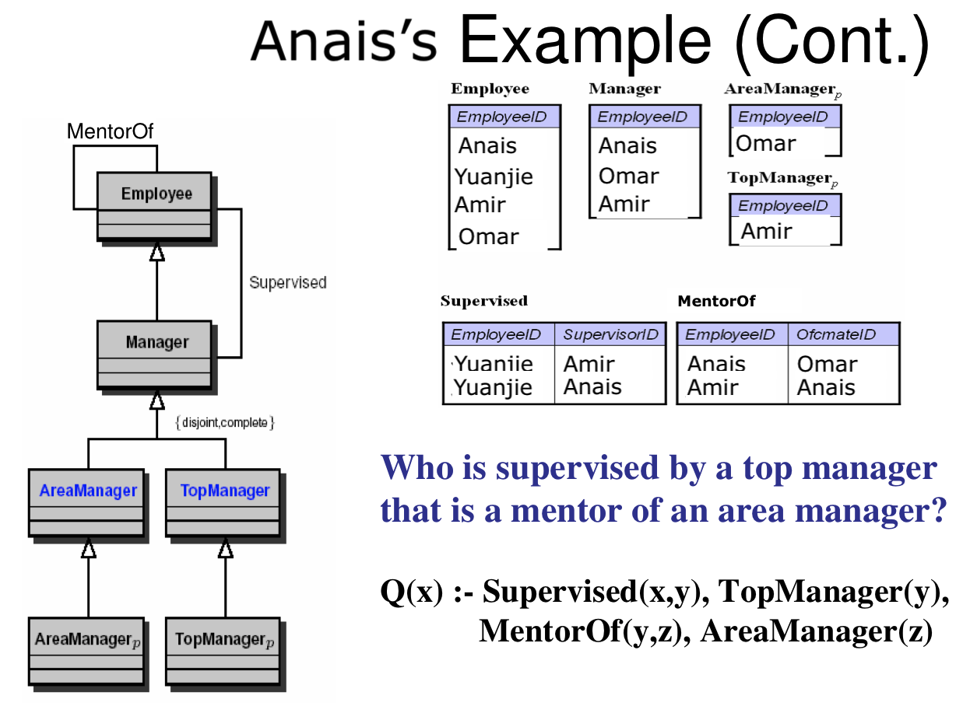
FOL test
What's the answer to the deductive database query Q(x)? That is, who satisfies x?
Assume the open world and unique names assumptions.

Slide 6
Pause for Q&A
This is where you get to ask me for help on your homework problems ... so don't be shy.

Slide 7

Let's do some problems
This is where you get to ask me for help on your homework problems ... so don't be shy.

Slide 8
In-class Exercises
𝐴∧⊥↔⊥
¬𝐴→(𝐴→𝐵)
𝑄→ ((𝑄→𝑅)→𝑅)
(Q→R)→R from hypothesis 𝑄
(𝐴→𝐵)→((𝐵→𝐶)→(𝐴→𝐶))
¬(𝐴∨𝐵) → (¬𝐴∧¬𝐵)
¬(𝐴∧𝐵) → (¬𝐴∨¬𝐵)
https://leanprover.github.io/logic_and_proof/natural_deduction_for_propositional_logic.html

Slide 9
Exam Time
We will examine and discuss past exams, so it is clear how that works and what you should spend your time focusing on learning.
Samples will be shared as we get closer to midterm exam time (week 6-7).

Slide 10
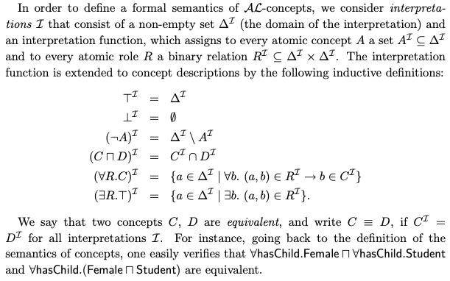
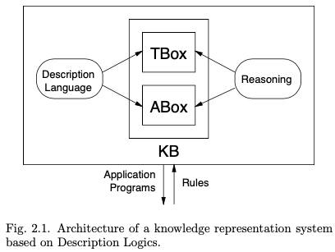
Description Logics — Semantic Web
Source: The Description Logic Handbook.

Slide 11
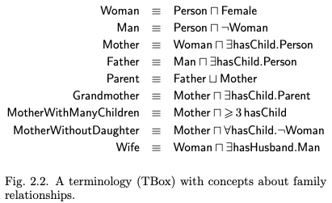
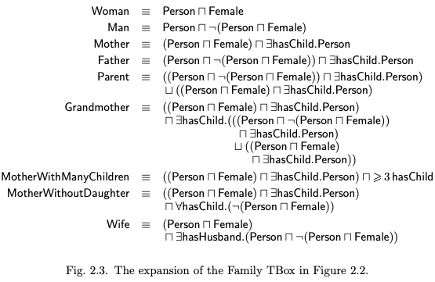
Description Logics — Semantic Web
Source: The Description Logic Handbook.

Slide 12
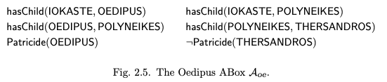
Description Logics — Semantic Web
Yes
Source: The Description Logic Handbook.

Slide 13
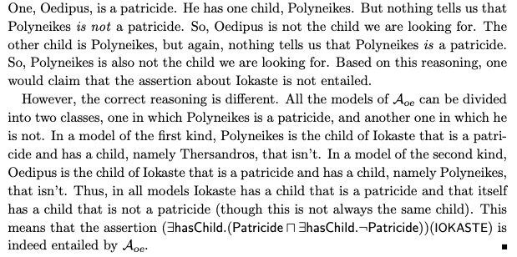
Description Logics — Semantic Web
Patricide or not Patricide? In either case ....
Source: The Description Logic Handbook.

Slide 14
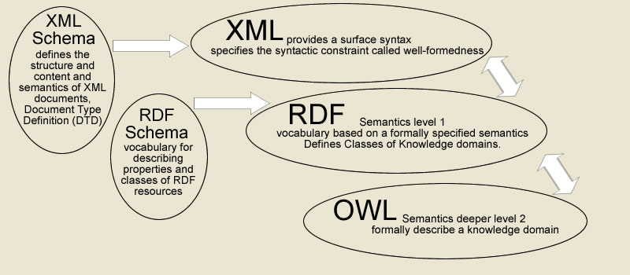
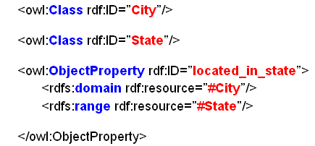
Description Logics — Semantic Web

Slide 15
Description Logics — Semantic Web
FOAF (friend of a friend)
http://xmlns.com/foaf/spec/
Dan lives in Zetland road, Bristol, UK with Libby and Craig. Dan's email address is danbri@w3.org. Libby's email address is libby.miller@bris.ac.uk. Craig's is craig@netgates.co.uk. Dan and Libby work for an organisation called "ILRT" whose website is at http://ilrt.org/. Craig works for "Netgates", an organisation whose website is at http://www.netgates.co.uk/. Craig's wife Liz lives in Bristol with Kathleen. Kathleen and Liz also work at "Netgates". Damian lives in London. Martin knows Craig, Damian, Dan and Libby quite well. Martin lives in Bristol and has an email address of m.l.poulter@bristol.ac.uk. (etc...)
<foaf:PersonalProfileDocument rdf:about="">
<foaf:maker rdf:resource="#me"/>
<foaf:primaryTopic rdf:resource="#me"/>
</foaf:PersonalProfileDocument>
<foaf:Person rdf:ID="me">
<foaf:name xml:lang="en">Henry Rzepa</foaf:name>
<foaf:givenname>Henry</foaf:givenname>
<foaf:family_name>Rzepa</foaf:family_name>
<foaf:title>Professor</foaf:title>
<foaf:img rdf:resource="http://www.ch.ic.ac.uk/rzepa/rzepa_2005.jpg"/>
<foaf:nick>rzepa</foaf:nick>
......
<!-- Knows -->
<foaf:knows rdf:resource="#EgonWillighagen"/>
<!-- PROJECTS -->
<foaf:currentProject>
<foaf:Project>
<foaf:organization>The Blue Obelisk Group</foaf:organization>
<foaf:homepage rdf:resource="http://www.blueobelisk.org/" />
</foaf:Project>
</foaf:currentProject>
</foaf:Person>
<!-- FRIENDS -->
<foaf:Person rdf:ID="EgonWillighagen">
<foaf:name>Egon Willighagen</foaf:name>
<rdfs:seeAlso rdf:resource="http://blueobelisk.sourceforge.net/people/egonw/foaf.xml"/>
<foaf:knows rdf:resource="#me"/>
</foaf:Person>

Slide 16
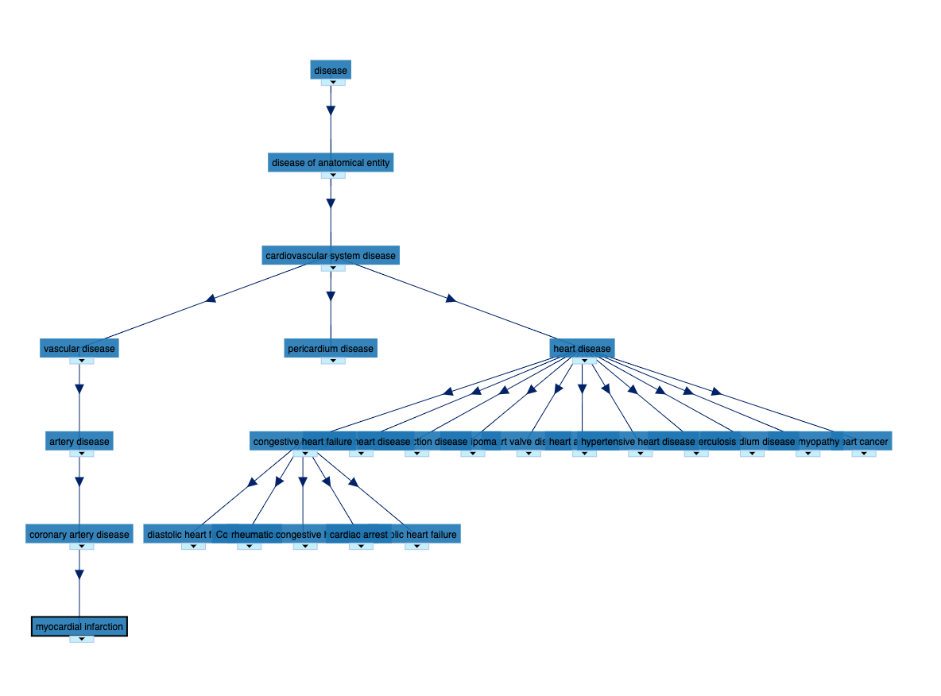
Description Logics — Semantic Web
Ontologies
http://bioportal.bioontology.org/ontologies
Protege Ontology Editor
https://protege.stanford.edu/
heart attack vs cardiac arrest

Slide 17
More FOL...
There are so many good resources... Here's a couple:
Duke: https://courses.cs.duke.edu//fall08/cps270/homework2.pdf
I love #2 as an exam question, the "do you like tofu," question as I call it
Cornell: https://www.cs.cornell.edu/courses/cs4700/2011fa/lectures/16_FirstOrderLogic.pdf
unification slides are fantastic
clausal form conversion algorithm slides are fantastic
resolution examples are fantastic
UMASS: https://people.umass.edu/partee/NZ_2006/More%20Answers%20for%20Practice%20in%20Logic%20and%20HW%201.pdf
great set of example problems

Slide 18
Next time
We begin Search

